Slide 1

Physical Education 101
Class #2

Slide 2
Making Healthy Choices
In Canada, the major causes of death are heart disease, cancer, stroke, and lung disease.
These lifestyle diseases are preventable.
Your habits now will dictate your health in the future.
Make healthy lifestyle choices now to ensure a better quality of life later on.

Slide 3
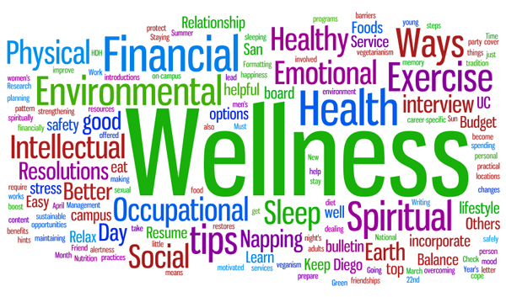
Total Health
This Photo by Unknown author is licensed under CC BY-SA-NC.
What are the 7 areas that make up our total health?

Slide 4
Total Health
PHYSICAL HEALTH: (getting enough sleep, being physically fit and active, eating well, the avoidance of smoking and drugs).
SOCIAL HEALTH: (having a good social support network, meeting new people)
INTELLECTUAL HEALTH: (stimulating your brain by problem solving, thinking creatively or critically)
FINANCIAL HEALTH: (save, budget and spend money within your means)
SPIRITUAL HEALTH: (having a faith or belief system, being compassionate and empathetic, living according to your values and morals)
EMOTIONAL HEALTH: (the ability to express your thoughts and feelings in a constructive manner, improving your self-esteem)
ENVIRONMENTAL HEALTH: (actions that will help maintain our current world resources and improve your health)

Slide 5
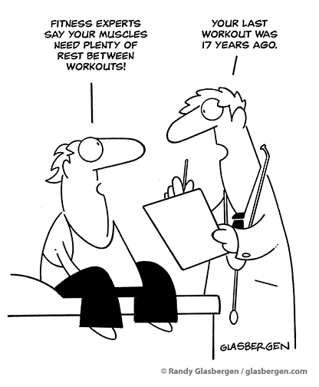
Barriers to Physical Activity

Slide 6
Barriers
Time | Cost
Knowledge | Does not value PA
Motivation | Fear of Injury
Injuries | Do not Enjoy
Access to a facility | Cost vs. Benefit
Weather | Intimidated
Pain | Too old/ sick

Slide 7
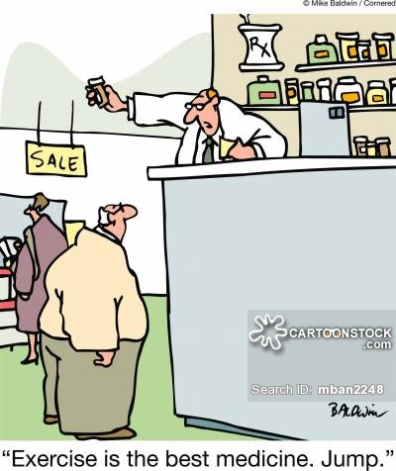
The Benefits of Physical Activity
Can we list some of the benefits from exercising/ physical activity?

Slide 8
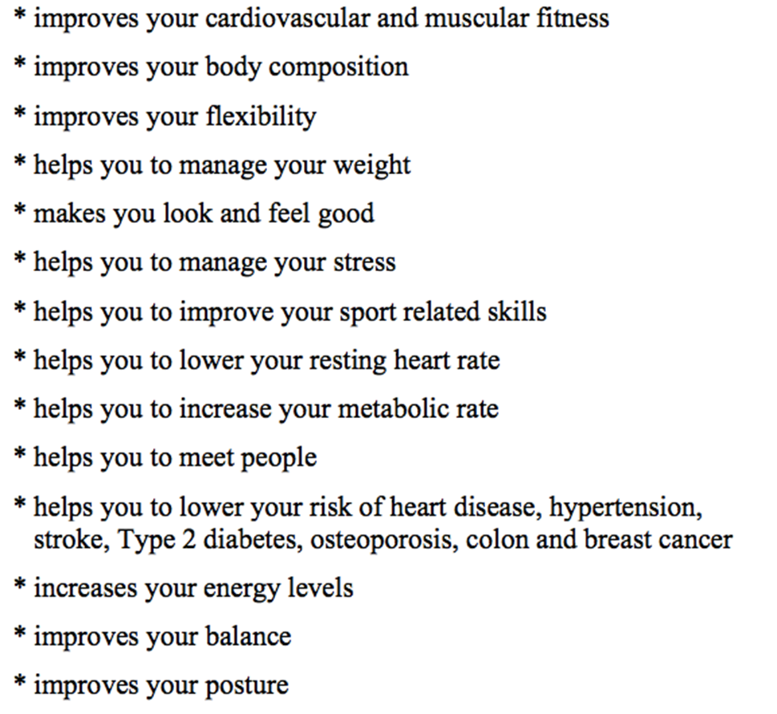
The Benefits of Physical Activity

Slide 9
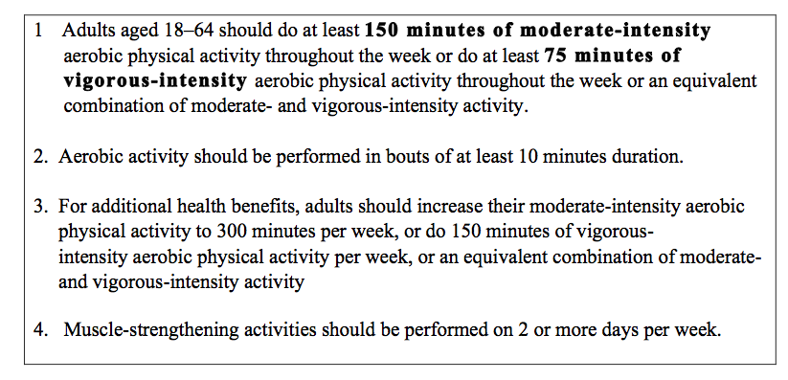
PHYSICAL ACTIVITY RECOMMENDATIONS FOR ADULTS:

Slide 10

Benefits to Physical Activity
Remember: Even a small amount of physical activity is better than not doing any physical activity

